Slide 1

APEX INSTITUTE OF TECHNOLOGY
DEPARTMENT OF COMPUTER SCIENCE & ENGINEERING
Statistics for Data Science(23CSH-233)
Faculty: Prof. (Dr.) Madan Lal Saini(E13485)
Inferential Statistics
DISCOVER . LEARN . EMPOWER

Slide 2
Statistics for Data Science : Course Objectives
COURSE OBJECTIVES
The Course aims to:
To equip students with the skills to summarize and interpret data using descriptive statistics and visualization techniques.
To develop a foundational understanding of probability and its applications in data science.
To enable students to perform hypothesis testing and construct confidence intervals for statistical inference.
To teach students how to build and assess linear and logistic regression models for predictive analysis.
To provide hands-on experience with statistical software for data manipulation, analysis, and visualization.

Slide 3
COURSE OUTCOMES
On completion of this course, the students shall be able to:-
CO1 | Summarize and describe the main features of a dataset using measures such as mean, median, mode, variance, and standard deviation, as well as graphical representations like histograms, box plots, and scatter plots.
CO2 | Understand of probability theory, including concepts such as random variables, probability distributions, and the law of large numbers, enabling them to model and reason about uncertainty in data.
CO3 | Apply/perform statistical inference, including hypothesis testing, confidence interval estimation, and p-value computation, to draw valid conclusions from sample data about larger populations.
CO4 | Apply linear and logistic regression techniques to identify relationships between variables, make predictions, and evaluate model performance.
CO5 | Utilize statistical software tools to perform data analysis, including data cleaning, transformation, visualization, and implementing various statistical methods.

Slide 4
Unit-3 Syllabus
Unit-3 | Inferential Statistics
Inferential Statistics & Hypothesis Testing | Statistical Inference Terminology, Hypothesis Testing, Parametric Tests, Non-parametric Tests
Industry Application | Hypothesis Testing using Excel Industry Practices & Applications of Statistics

Slide 5
SUGGESTIVE READINGS
TEXT BOOKS:
T1. Hastie, Trevor, et al., The elements of statistical learning. Vol. 2. No. 1. New York: Publisher: Springer, Edition: Second Edition (2009), ISBN: 978-0387848570
T2. Montgomery, Douglas C., and George C. Runger. Applied statistics and probability for engineers. John Wiley & Sons, 2010.
T3. Probability and Statistics The Science of Uncertainty Second Ed., Michael J. Evans and Jeffrey S. Rosenthal.
REFERENCE BOOKS:
R1. Practical Statistics for Data Scientists: 50 Essential Concepts, Authors: Peter Bruce, et al, Publisher: O'Reilly Media, Edition: Second Edition (2020), ISBN: 978-1492072942
R2. An Introduction to Statistical Learning: with Applications in R, Authors: Gareth James, et al, Publisher: Springer, Edition: Second Edition (2021), ISBN: 978-1071614174
R3. Think Stats: Exploratory Data Analysis in Python, Author: Allen B. Downey, Publisher: O'Reilly Media, Publication Year: 2014 (2nd Edition), ISBN: 978-1491907337

Slide 6
What is a Statistic????
Sample
Sample
Population
Sample
Sample
Parameter: value that describes a population
Statistic: a value that describes a sample
PSYCH → always using samples!!!

Slide 7
Descriptive & Inferential Statistics
Descriptive Statistics
Organize
Summarize
Simplify
Presentation of data
Inferential Statistics
Generalize from samples to pops
Hypothesis testing
Relationships among variables
Describing data
Make predictions

Slide 8
Descriptive Statistics
3 Types
1. Frequency Distributions
3. Summary Stats
# of Ss that fall
in a particular category
Describe data in just one
number
2. Graphical Representations
Graphs & Tables

Slide 9
1. Frequency Distributions
# of Ss that fall
in a particular category
How many males and how many females are
in our class?
total
Frequency
(%)
? ?
?/tot x 100 ?/tot x 100
-----% ------%
scale of measurement?
nominal

Slide 10
1. Frequency Distributions
# of Ss that fall
in a particular category
Categorize on the basis of more that one variable at same time
CROSS-TABULATION
total
Democrats
Republican
24 1 25
19 6 25
Total 43 7 50

Slide 11
1. Frequency Distributions
How many brothers & sisters do you have?
# of bros & sis Frequency
7 ?
6 ?
5 ?
4 ?
3 ?
2 ?
1 ?
0 ?

Slide 12
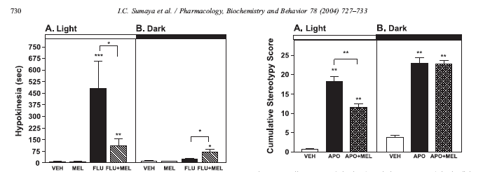
2. Graphical Representations
Graphs & Tables
Bar graph (ratio data - quantitative)

Slide 13
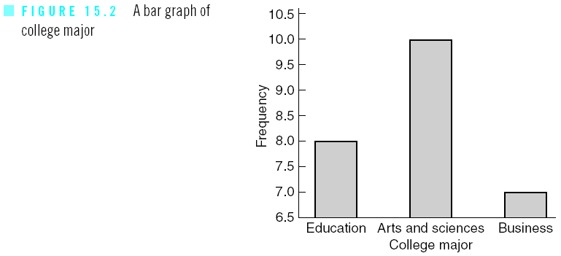
2. Graphical Representations
Histogram of the categorical variables

Slide 14
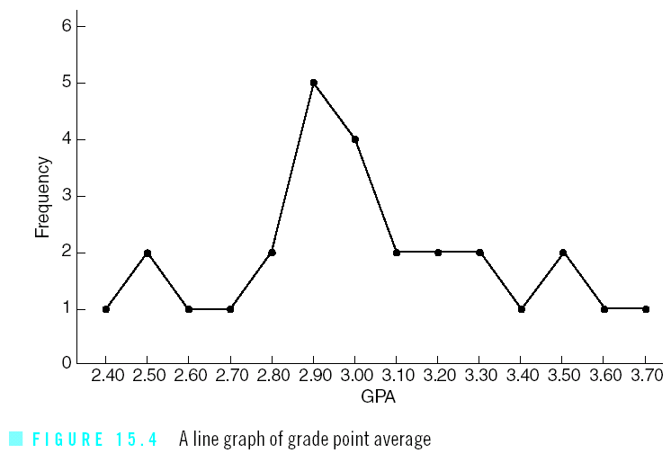
2. Graphical Representations
Polygon - Line Graph

Slide 15
2. Graphical Representations
Graphs & Tables
How many brothers & sisters do you have?
Lets plot class data: HISTOGRAM
# of bros & sis Frequency
7 ?
6 ?
5 ?
4 ?
3 ?
2 ?
1 ?
0 ?

Slide 16
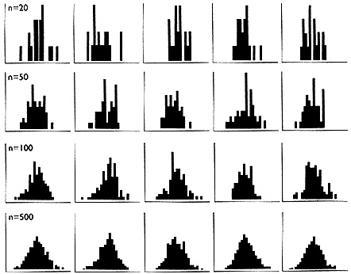
jagged
Altman, D. G et al. BMJ 1995;310:298
smooth
Central Limit Theorem: the larger the sample size, the closer a distribution
will approximate the normal distribution or
A distribution of scores taken at random from any distribution will tend to
form a normal curve

Slide 17
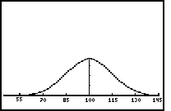
Normal Distribution:
half the scores above mean…half below
(symmetrical)
68%
95%
13.5%
13.5%
IQ
body temperature, shoe sizes, diameters of trees,
Wt, height etc…

Slide 18
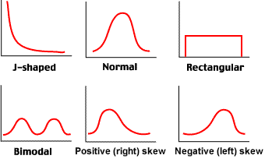

Slide 19
Summary Statistics describe data in just 2 numbers
Measures of variability
typical average variation
Measures of central tendency
typical average score

Slide 20
Measures of Central Tendency
Quantitative data:
Mode – the most frequently occurring observation
Median – the middle value in the data (50 50 )
Mean – arithmetic average
Qualitative data:
Mode – always appropriate
Mean – never appropriate

Slide 21
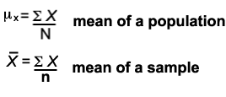
Mean
Notation
The most common and most useful average
Mean = sum of all observations number of all observations
Observations can be added in any order.
Sample vs population
Sample mean = X
Population mean =μ
Summation sign =
Sample size = n
Population size = N

Slide 22
Special Property of the Mean Balance Point
The sum of all observations expressed as positive and negative deviations from the mean always equals zero!!!!
The mean is the single point of equilibrium (balance) in a data set
The mean is affected by all values in the data set
If you change a single value, the mean changes.

Slide 23
The mean is the single point of equilibrium (balance) in a data set
SEE FOR YOURSELF!!! Lets do the Math

Slide 24
Summary Statistics describe data in just 2 numbers
Measures of variability
typical average variation
Measures of central tendency
typical average score
range: distance from the lowest to the highest (use 2 data points)
2. Variance: (use all data points)
3. Standard Deviation
4. Standard Error of the Mean

Slide 25
Descriptive & Inferential Statistics
Descriptive Statistics
Organize
Summarize
Simplify
Presentation of data
Inferential Statistics
Generalize from samples to pops
Hypothesis testing
Relationships among variables
Describing data
Make predictions

Slide 26
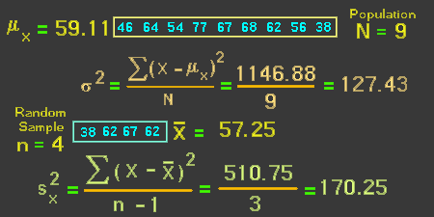
Measures of Variability
2. Variance: (use all data points):
average of the distance that each score is from the mean (Squared deviation from the mean)
Νotation for variance
s²
3. Standard Deviation= SD= s²
4. Standard Error of the mean = SEM = SD/ n

Slide 27
Inferential Statistics
Sample
Sample
Population
Sample
Sample
Draw inferences about the
larger group

Slide 28
Sampling Error: variability among
samples due to chance vs population
Or true differences? Are just due to
sampling error?
Probability…..
Error…misleading…not a mistake

Slide 30
data
Are our inferences valid?…Best we can do is to calculate probability
about inferences

Slide 31
Inferential Statistics: uses sample data to evaluate the credibility of a hypothesis about a population
NULL Hypothesis:
NULL (nullus - latin): “not any” → no
differences between means
H₀ : μ₁ = μ₂
Always testing the null hypothesis
“H- Naught”

Slide 32
Inferential statistics: uses sample data to evaluate the credibility of a hypothesis about a population
Hypothesis: Scientific or alternative
hypothesis
Predicts that there are differences between the groups
H₁ : μ₁ = μ₂

Slide 34
Inferential Statistics
When making comparisons
btw 2 sample means there are 2
possibilities
Null hypothesis is false
Null hypothesis is true
Reject the Null hypothesis
Not reject the Null Hypothesis

Slide 35
Type I Error: Rejecting a True Hypothesis
Type II Error: Accepting a False Hypothesis

Slide 37
ALPHA
the probability of making a type I error → depends on the criterion you use to accept or reject the null hypothesis = significance level (smaller you make alpha, the less likely you are to commit error) 0.05 (5 chances in 100 that the difference observed was really due to sampling error – 5% of the time a type I error will occur)
Alpha (a)
Difference observed is really
just sampling error
The prob. of type one error

Slide 38
When we do statistical analysis… if alpha
(p value- significance level) greater than 0.05
WE ACCEPT THE NULL HYPOTHESIS
is equal to or less that 0.05 we
REJECT THE NULL (difference btw means)

Slide 41
BETA
Probability of making type II error → occurs when we fail to reject the Null when we should have
Beta (β)
Difference observed is real
Failed to reject the Null
POWER: ability to reduce type II error

Slide 42
POWER: ability to reduce type II error
(1-Beta) – Power Analysis
The power to find an effect if an effect is present
Increase our n
2. Decrease variability
3. More precise measurements
Effect Size: measure of the size of the difference
between means attributed to the treatment

Slide 43
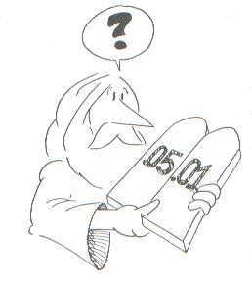
Inferential statistics
Significance testing:
Practical vs statistical significance

Slide 44
Inferential statistics
Used for Testing for Mean Differences
T-test: when experiments include only 2 groups
Independent
b. Correlated
i. Within-subjects
ii. Matched
Based on the t statistic (critical values) based on
df & alpha level

Slide 45
Inferential statistics
Used for Testing for Mean Differences
Analysis of Variance (ANOVA): used when
comparing more than 2 groups
1. Between Subjects
2. Within Subjects – repeated measures
Based on the f statistic (critical values) based on
df & alpha level
More than one IV = factorial (iv=factors)
Only one IV=one-way anova

Slide 46
Inferential statistics
Meta-Analysis:
Allows for statistical averaging of results
From independent studies of the same
phenomenon

Slide 47
References
Books:
Hastie, Trevor, et al., The elements of statistical learning. Vol. 2. No. 1. New York: Publisher: Springer, Edition: Second Edition (2009), ISBN: 978-0387848570
Practical Statistics for Data Scientists: 50 Essential Concepts, Authors: Peter Bruce, et al, Publisher: O'Reilly Media, Edition: Second Edition (2020), ISBN: 978-1492072942
Research Papers:
Garg, Ram and Goyal, Ruchi, Inferential Statistics As a Measure of Judging the Short-Term Solvency An Empirical Study of Three Steel Companies in India (February 5, 2019). International Journal of Advanced Studies of Scientific Research, Vol. 4, No. 1, 2019, Available at SSRN: https://ssrn.com/abstract=3329388.
Alacaci, C. (2004). Inferential Statistics: Understanding Expert Knowledge and its Implications for Statistics Education. Journal of Statistics Education, 12(2). https://doi.org/10.1080/10691898.2004.11910737
Websites:
https://www.simplilearn.com/inferential-statistics-article/
https://builtin.com/data-science/inferential-statistics#:~:text=Inferential%20statistics%20is%20the%20practice,sample%20data%20sample%20or%20population./
Videos:
https://www.youtube.com/watch?v=cjTgyRUaD1s&list=PLbRMhDVUMngeD_vOeveVE-3b7wu_AZph9
https://www.youtube.com/watch?v=ZmCBF5JXOPM&list=PLFW6lRTa1g80s2MWqXNg2o0haq1k14v2I

Slide 48
THANK YOU
For queries
Email: madan.e13485@cumail.in

